Slide 1
The effect of TGF-BETA on GENE expression of Drosophila Under alcohol exposure
Michael Vuong

Slide 2
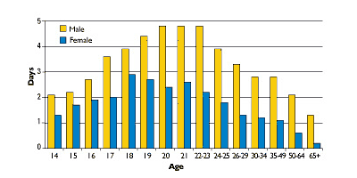

Slide 3
Alcohol Study
According to National Institute on Alcohol Abuse and Alcoholism
1 in 4 people binge drink (Consume more than 5 drinks within 2 hours)
22 percent women binge drink and 42 percent of men binge drink

Slide 4
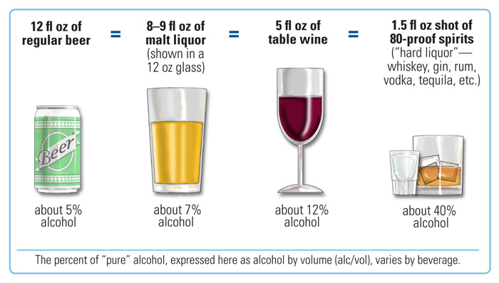

Slide 5
Alcohol Disorder/Dependence
Greater risk of certain cancers
Weakened immune system
Greater risk of heart disorders
Damage to the central nervous system
Dependent

Slide 6
More Statistics
An estimated 18 million people in the United States have an alcohol disorder in the form of abuse or dependence
Majority of disorders stems from tolerance= the acquired resistance to the substance

Slide 7
What can we do?
Genetic versus Environmental factors that lead to development of alcohol abuse and disorders
Lots of research regarding environmental factors (Spit for Science)

Slide 8
However…
VERY little is known about the genetic pathways with established roles in human alcohol disorder

Slide 9
Unfortunately…
Genetic and molecular pathway investigations are difficult to perform in human population due to the widespread variety of the factors

Slide 10
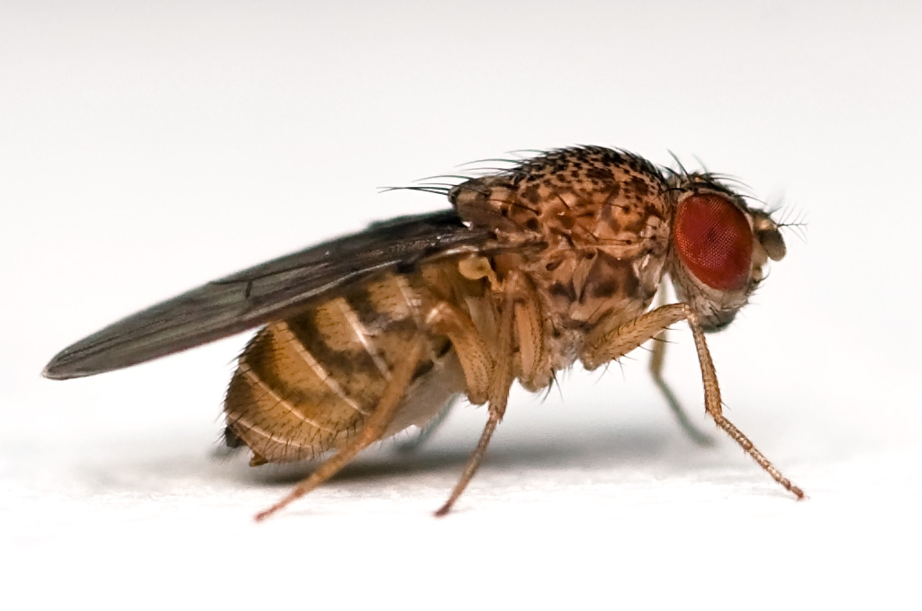
In order to investigate this…

Slide 11
Drosophila melanogaster
Model Organism
Very useful for genetic experiments
Easy to grow and care for
Distinguishable
High fecundity
Recognizable similarities between human and fly genes

Slide 12
Discovery of CLIC
Banderia et al (2012) discovered Chloride Intracellular Channel proteins played a major role in development of ethanol sensitivity in flies
However, mechanism underlying the relationship is still unknown

Slide 13
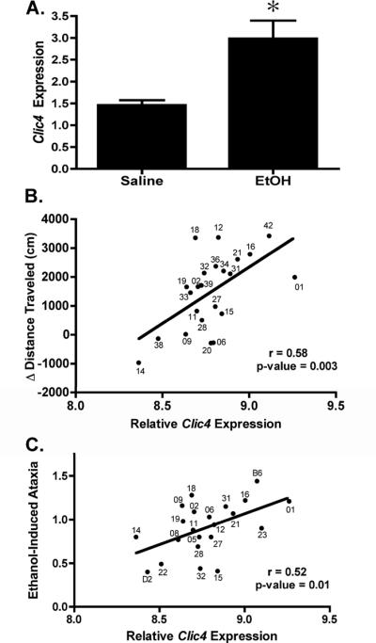

Slide 14
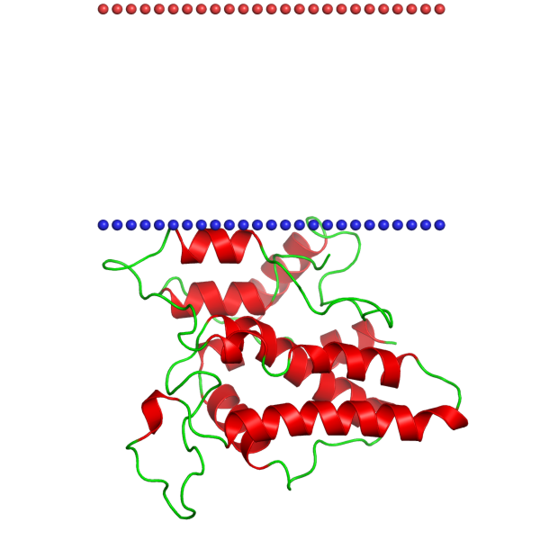

Slide 15
Transforming Growth Factor-Beta Signaling Pathway
Shukla et al (2009) discovered that CLIC is a major part of TGF-beta signaling pathway
Interacts with Smad proteins

Slide 16
Not enough…
Though we know it is part of the pathway, we still do not understand the genetic/molecular effects on ethanol sensitivity
How does a transcription pathway affect alcohol tolerance similar to the way CLIC does?
What genes are being affected?

Slide 17
Aim of Experiment
Assess all genes that are being expressed when flies are exposed to alcohol
Compare genes that are expressed when Smad proteins are active versus silenced as well as with alcohol exposure and without exposure

Slide 18
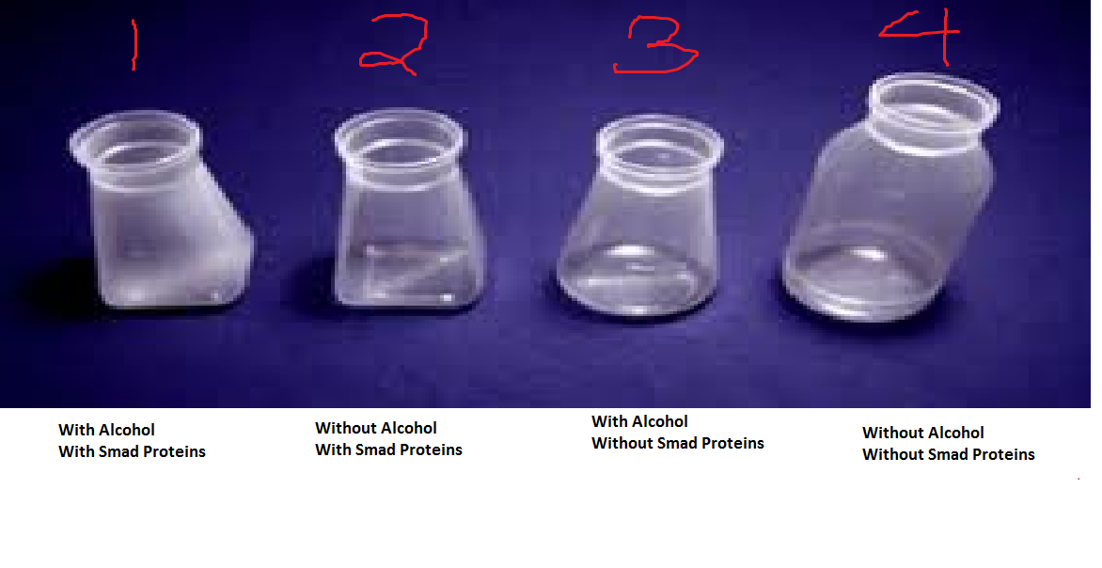

Slide 19
Silencing
RNAi injection is a method used to silence a particular gene from making the proteins it encodes
Two groups of the flies have Smad silenced
Waiting period

Slide 20
Main Method
DNA microarray
Allows one to experiment on thousands of genes, entire drosophila genome
Precise location of each gene recorded
Arranged in rows on a glass microscope slide-sized chip

Slide 21
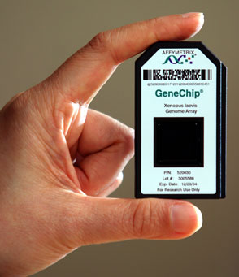

Slide 22
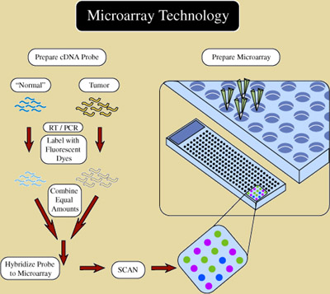

Slide 23
DNA Microarray
Drosophila exposed to ethanol vapor
mRNA extracted from cells taken from Drosophila
Single strand cDNA made from mRNA through reverse transcriptase
cDNA colored with fluorescent dye for easier visibility on microarray
Combination of two groups of flies placed together on the microarray

Slide 24
DNA Microarray cont.
Gene expression= making of RNA/protein
Black dots indicate gene expression does not change
Green and red dots indicate expression of that gene in the group

Slide 25
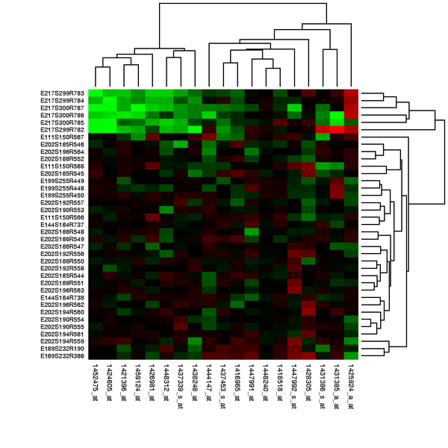

Slide 26
What does this mean?
Genes that are black mean nothing
The genes that are colored differently indicate expression only in those conditions
Genes cataloged for further experiments

Slide 27
Problems
Results of the microarrays may be unclear so multiple trials may have to be done

Slide 28
First Step
This is only a first step in determining how CLIC and many other genes affect development of alcohol sensitivity and disorder
No guarantee that these genes will apply to humans
Multi-organism experiment should be done

Slide 29
Why does this matter?
The information from this experiment could be used for several future applications
Designing therapeutic treatment for alcohol disorder
Run diagnostics tests for patients predisposed to alcohol disorder
Drugs to prevent alcohol disorders at genetic level

Slide 30
References
Bhandari, P., J. S. Hill, S. P. Farris, B. Costin, I. Martin, C. L. Chan, J. T. Alaimo, J. C. Bettinger, A. G. Davies, M. F. Miles and M. Grotewiel (2012). "Chloride intracellular channels modulate acute ethanol behaviors in Drosophila, Caenorhabditis elegans and mice." Genes Brain Behav 11(4): 387-97
Kong EC, Allouche L, Chapot PA, Vranizan K, Moore MS, Heberlein U, Wolf FW. " Ethanol-regulated genes that contribute to ethanol sensitivity and rapid tolerance in Drosophila." Alcohol Clin Exp Res. 2010 Feb;34(2):302-16
Shukla, A., M. Malik, C. Cataisson, Y. Ho, T. Friesen, K. S. Suh and S. H. Yuspa (2009). "TGF-beta signalling is regulated by Schnurri-2-dependent nuclear translocation of CLIC4 and consequent stabilization of phospho-Smad2 and 3." Nat Cell Biol 11(6): 777-84.Berryman, M. A. and J. R. Goldenring (2003). "CLIC4 is enriched at cell-cell junctions and colocalizes with AKAP350 at the centrosome and midbody of cultured mammalian cells." Cell Motil Cytoskeleton 56(3): 159-72.
http://learn.genetics.utah.edu/content/labs/microarray/
Morozova TV, Ayroles JF, Jordan KW, Duncan LH, Carbone MA, Lyman RF, Stone EA, Govindaraju. " Alcohol sensitivity in Drosophila: translational potential of systems genetics." Genetics. 2009 Oct;183(2):733-45, 1SI-12SI.
Shanks, R. A., M. C. Larocca, M. Berryman, J. C. Edwards, T. Urushidani, J. Navarre and J. R. Goldenring (2002). "AKAP350 at the Golgi apparatus. II. Association of AKAP350 with a novel chloride intracellular channel (CLIC) family member." J Biol Chem 277(43): 40973-80.

